Slide 1



EXPEDITING HR MANAGEMENT VIA DYNAMIC E-PORTFOLIO BY EMPLOYING WEB SCRAPPER
JEEVAN AKSHAY B (211419104113)
KEVIN CHRISTOPHER A (211419104140)
MOHAMMED ABDULLAH (211419104167)
Guide Name
Mr. KARTHIKEYAN A, B.E., M.TECH.,
Coordination Name
Dr. Senthil Kumar M.C.A., M.Phil., M.B.A.,M.E., Ph.D.,

Slide 2
INTRODUCTION
Be it promotion or recruitment, HR management is all about giving the right people the right role.
Resume printed on paper can serve as an excellent medium to communicate about oneself to the job recruiter.
These days jobs with quality income require the candidates appearing for the interview to apply online.
However, portfolio hosted on web can aid a student to express projects and achievements. The samples of projects can be displayed through the website.
There are technologies such as web scraping which is an automated method to obtain large amounts of data from websites.
Most of this data is unstructured data in an HTML format which is then converted into structured data in a spreadsheet or a database so that it can be used in various applications.
To make portfolio more robust and dynamic with real-time content updates, this paper introduces the concept of employing a web scrapper to fetch project details from websites like GitHub and certificates from certificate providers such as Coursera.

Slide 3
Objective Of The Project
The process of scraping data from the Internet can be divided into two sequential steps; acquiring web resources and then extracting desired information from the acquired data.
Specifically, a web scraping program starts by composing a HTTP request to acquire resources from a targeted website.
This request can be formatted in either a URL containing a GET query or a piece of HTTP message containing a POST query.
Once the request is successfully received and processed by the targeted website, the requested resource will be retrieved from the website and then sent back to the give web scraping program.
The resource can be in multiple formats, such as web pages that are built from HTML, data feeds in XML or JSON format, or multimedia data such as images, audio, or video files.
After the web data is downloaded, the extraction process continues to parse, reformat, and organize the data in a structured way .

Slide 4
LITERATURE REVIEW
Author | Title | DOI/ Reference | Findings | Publised
Geunseong Jung, Sungjae Han, Hansung Kim, Kwanguk Kim | Extracting the Main Content of Web Pages Using the First Impression Area | https://doi.org/10.1109/ACCESS.2022.3229080 | Extracting the main content from a web using web crawlers and browser reader modes. | 14 December 2022
Siew Lee Chang & Muhammad Kamarul Kabilan | Using social media as e-Portfolios to support learning in higher education: a literature analysis | https://doi.org/10.1007/s12528-022-09344-z | Use of (Social Media) SM-based e-Portfolios’ potentials to support and facilitate students’ learning and development. | 16 November 2022
Asih Zunaidah | Meaningful Online Learning with e-Portfolio: University Students’ Perspectives | https://doi.org/10.1109/ICET56879.2022.9990059 | During emergency online classes, students were engaged in the learning process while utilizing digital technology through e-portfolio. | 23 December 2022

Slide 5
PROBLEM STATEMENT
The job recruiters generally refer to the resume for getting summarized view of candidate’s profile.
This is generally shown in the printout by the candidate to the recruiter. Thus it has the limitation of just summarizing the information.
These days, jobs with quality income require the candidates appearing for the interview to apply online.
Portfolio hosted on web can serve as a good means to tell more about the projects which had been completed by the candidate.
Other possible alternatives include online social media sites LinkedIn. The LinkedIn app is meant to connect people with similar interests and jobs.
Thus it is not specialized for displaying the projects and experience in internships.
The samples of projects can be displayed via the website. Generally, resume is meant to be a summary of the candidate’s profile.
On the other hand, portfolio is meant to be more descriptive about the candidate. The achievements of candidates might contain some extra information about the learnings and how the issues were resolved.

Slide 6
DEVELOPMENT ENVIRONMENT
Software Requirements
The following are the packages and libraries required to build the application:
Node.js – version (16.15.0 LTS)
React-router-dom@6
Firebase (OAuth, Storage)
ExpressJS (REST API)
Socket.IO (Socket Programming for sharing real-time content)
Puppeteer (To launch browser in headless mode)
Other npm packages included in the application as dependencies are as follows:
@mui/material
@emotion/react
@emotion/styled
HARDWARE REQUIREMENTS
8 GB RAM (To run puppeteer)
Network interface to connect to internet,
Download Speed: 25 Mbps
Upload Speed: 5 Mbps.

Slide 7
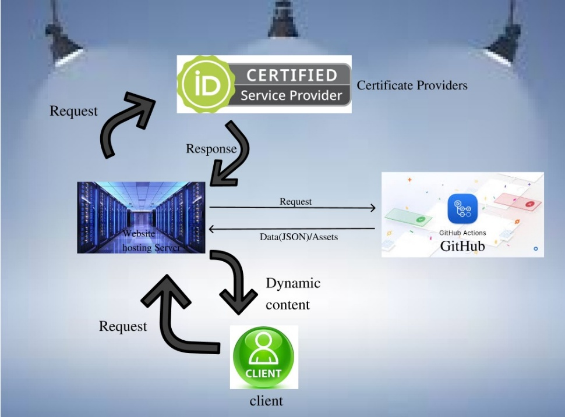
SYSTEM ARCHITECTURE

Slide 8
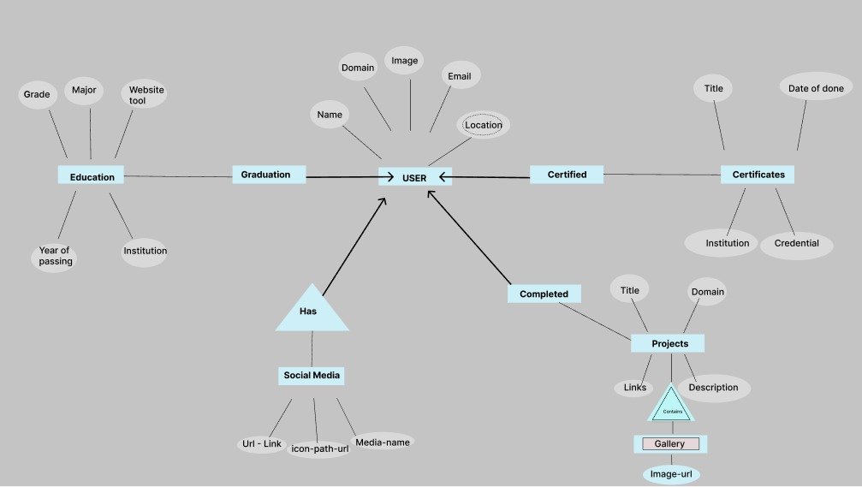
SYSTEM DESIGN E-R Diagram

Slide 9
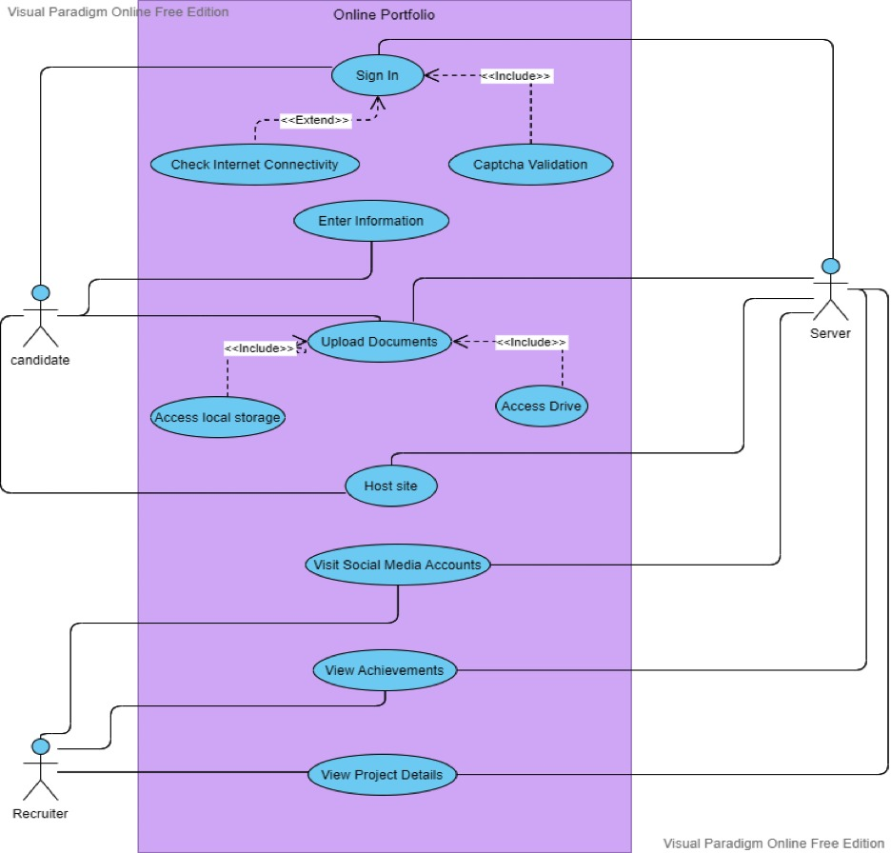
SYSTEM DESIGN USE CASE DIAGRAM

Slide 10
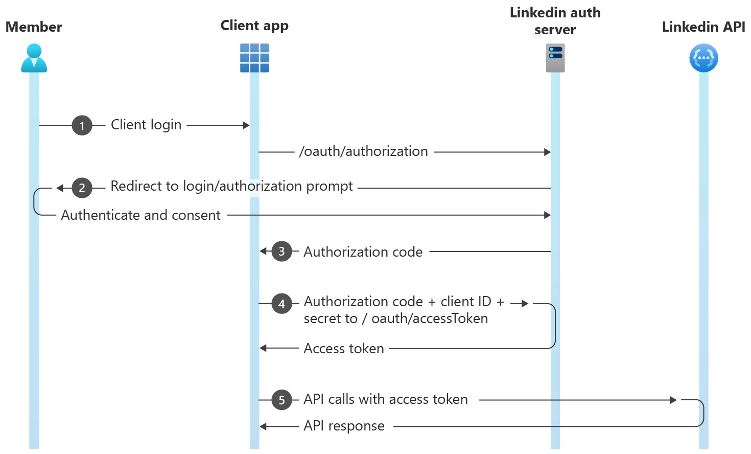
SYSTEM DESIGN SEQUENCE DIAGRAM
For Authentication (From Linkin API):

Slide 11
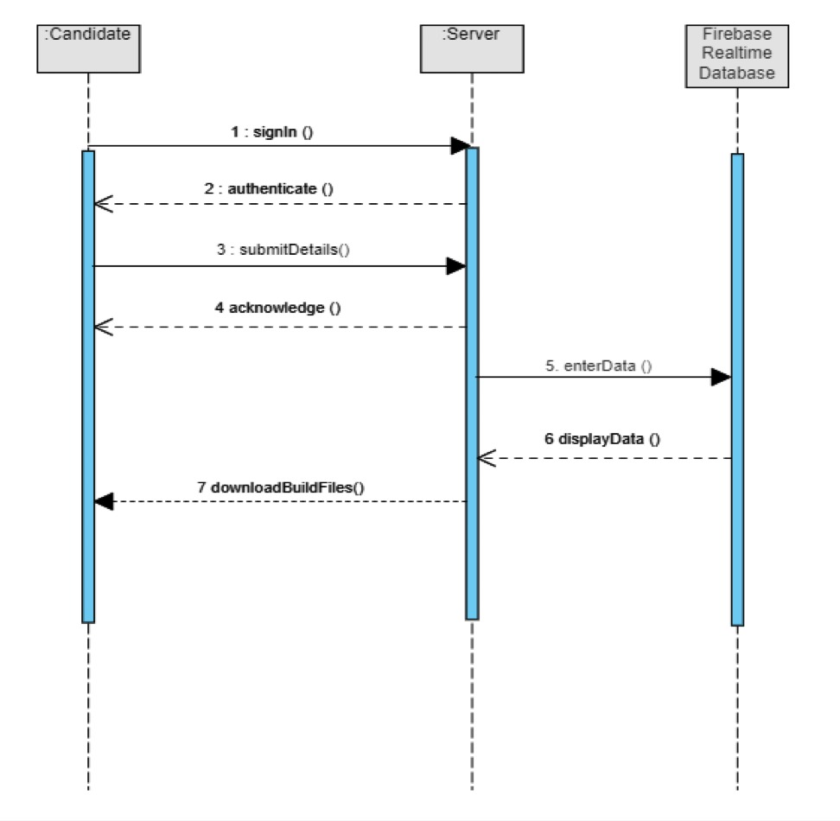
SYSTEM DESIGN SEQUENCE DIAGRAM
For storing and retrieving data

Slide 12
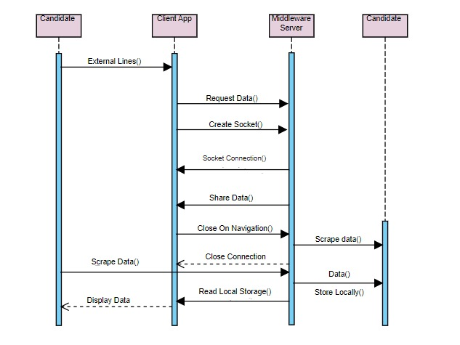
SYSTEM DESIGN SEQUENCE DIAGRAM
Dynamically display Github and related data & scrape data from linkedIn

Slide 13
MODULE DESRIPTION FIREBASE
LOCATION:
Root-folder
|--firebase.js
|--src
|--App.js
|--firebase-config
FUNCTION:
To perform authentication for existing user and to register a new user.
To store and retrieve data from Realtime Database.
To host the website in the server
DEPENDENCIES:
Firebase CLI
NPM modules:
@firebase/app
@firebase/auth
@firebase/database

Slide 14
MODULE DESRIPTION WEB SCRAPPER CLIENT
LOCATION:
Root-folder
|--src
|--Components
|--Callback
| |--CallbackHandler.js
|--Form
| |--Form.js
|--Projects
|--Projectpage.js
|--Model.js
FUNCTION:
To receive and display images from middleware server in projects.
To scrape data from linkedIn
DEPENDENCIES:
NPM modules:
@express
@puppeteer
@socket.io-client

Slide 15
MODULE DESRIPTION MIDDLEWARE SERVER
LOCATION:
Root-folder
|--index.js
|--screenhot.png
|--screen.shooter.js
FUNCTION:
Screenshot.png is used for store the screenshots taken by puppeteer, which is later sent to the client
This process is achieved with established socket connection.
DEPENDENCIES:
NPM modules:
@puppeteer
@socket.io

Slide 16
MODULE DESRIPTION WEBSCRAPER SERVER
LOCATION:
Root-folder
|--data
|--data.js
|--index.js
FUNCTION:
Query Selectors are used to select the content from the web page and store it in the files under data directory.
Express server listens on a port for request to provide the data from files
This content is retrieved from the data directory when a GET request is made.
Promises are used to execute asynchronously
DEPENDENCIES:
NPM modules:
@puppeteer
@socket.io
@express

Slide 17
MODULE DESRIPTION REACT BROWSER ROUTER
LOCATION:
Root-folder
|--src
|--App.js
|--Components
|--Home
|--Home.js
FUNCTION:
There are two routers present in the application.
The one present in App.js handles the login, registration and form page navigation.
The browser router present in Home.js handles the navigation when the user navigates through the portfolio.
DEPENDENCIES:
NPM modules:
@browser-router

Slide 18
TESTING
TEST CASE ID | TEST SCENARIO | TEST CASE | PRE-CONDITON | TEST STEPS | TEST DATA | EXPECTED RESULT | POST CONDITION | ACTUAL OUTCOME | STATUS (PASS/ FAIL)
1. | Verify username detail | Enter Credentials | Should have a valid portfolio account | 1.Enter username 2.Click submit | <Valid login username> | Verify login access with correct credentials | Navigate to form data page | Logged in page is shown | Pass
2 | Verify information | Enter invalid credentials | Should have a valid portfolio account | 1.Enter Username 2.Enter password 3. Click submit | <Invalid credentials | Error message | Stay in same page | Error message | pass
3. | Verify password detail | Enter Password | Should have a valid portfolio account | 1. Enter Pasword 2. Wait for 200ms for auto change function to complete | <Valid password> | Verify whether it is minimum of 6 characters | Show data page | Error message is hidden | Pass
4 | Click the submit button for the form | Click submit Button | Should have filled both username and password | 1.Enter required fields. 2.Enter submit | <Valifd button field> | Check whether button is enabled | Show login page | Button is enabled | Pass

Slide 19
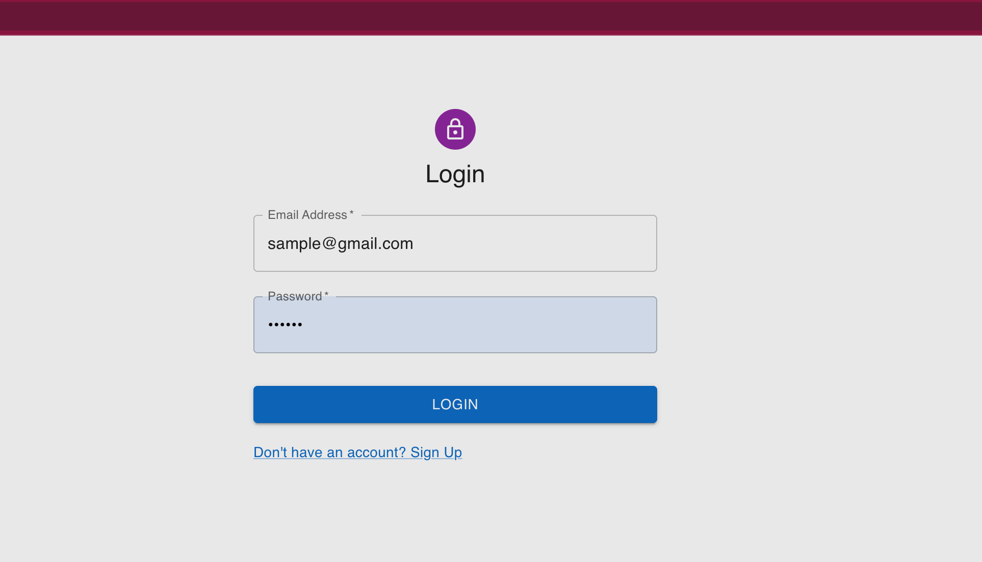
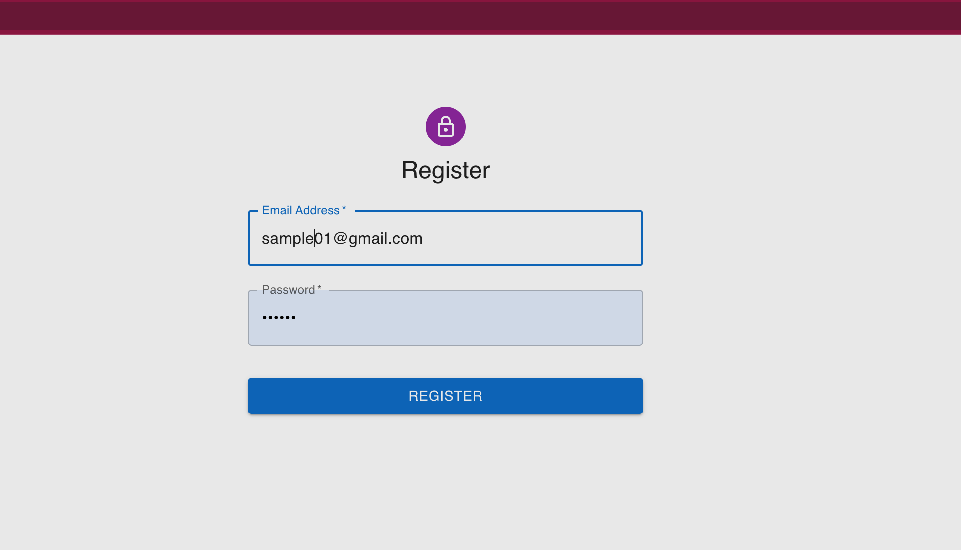
SCREENSHOTS
Fig 1. Registration Screen
Fig 2. Login Screen

Slide 20
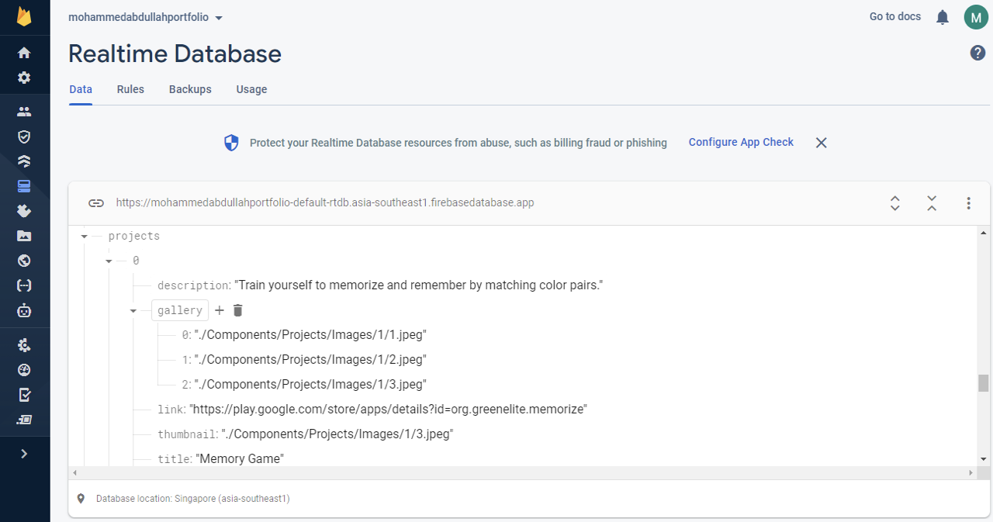
SCREENSHOTS
Fig 3. Store data in Firebase BaaS

Slide 21
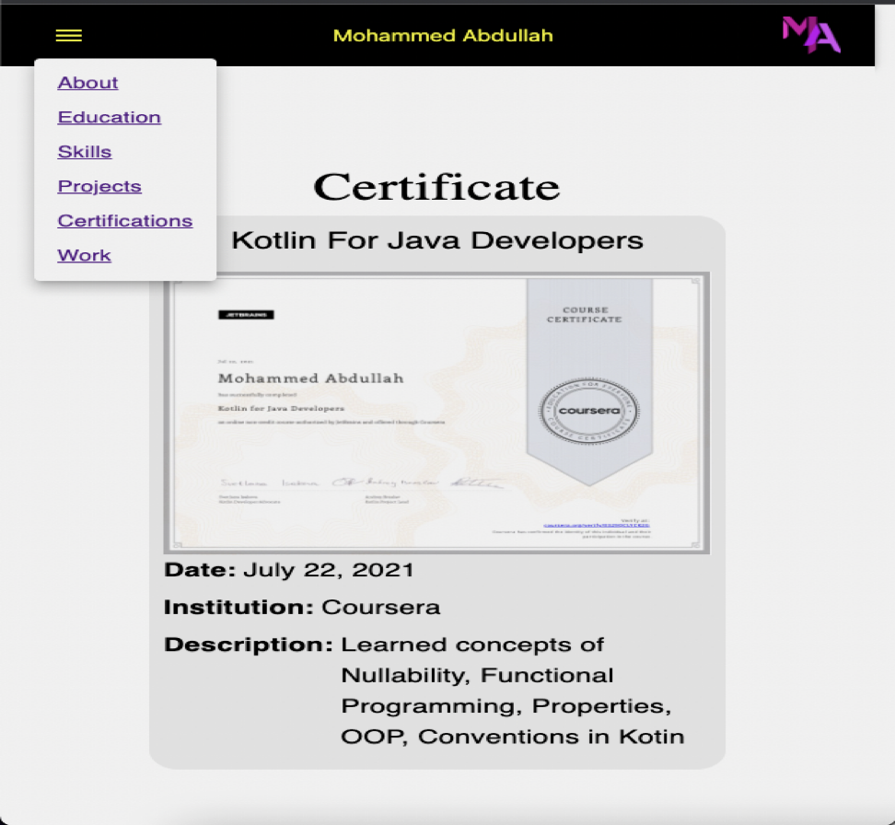
SCREENSHOTS
Fig 4. Supported Mobile Responsiveness using MUI

Slide 22
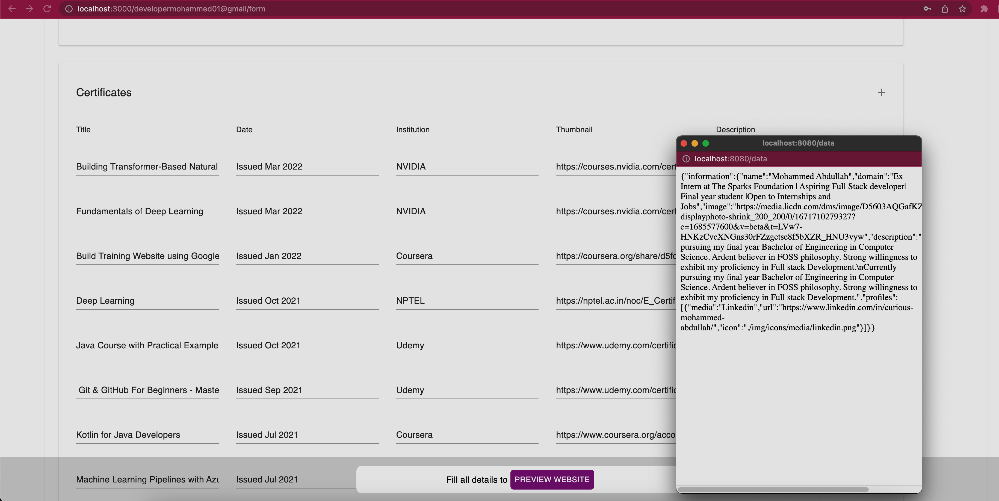
SCREENSHOTS
Fig 5. Auto-fill using scrapped data

Slide 23
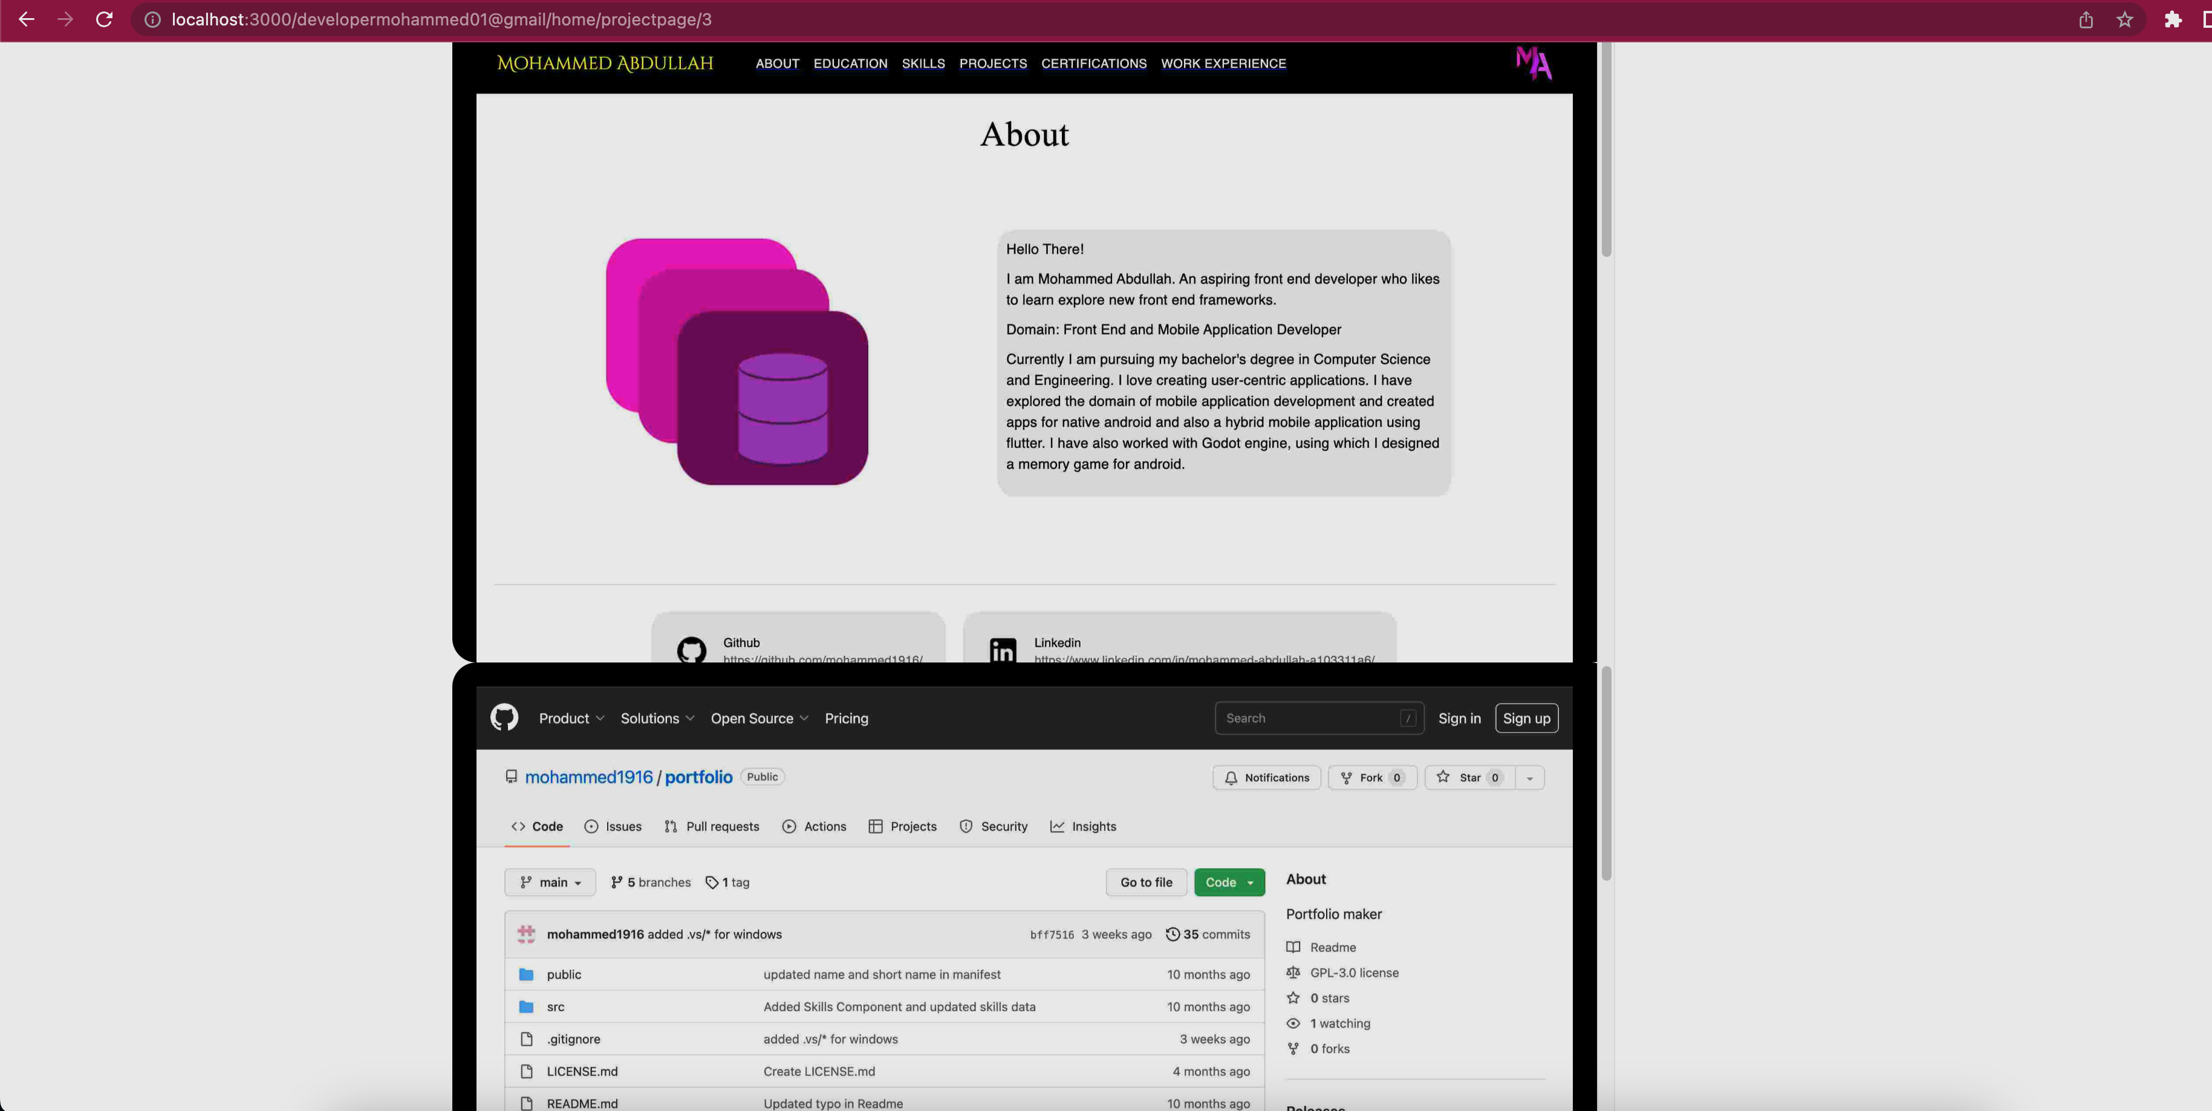
SCREENSHOTS
Fig 6. Dynamic viewing of content using socket connection and puppeteer
Top: Project hosting
Bottom: GitHub ReadMe.md file

Slide 24
CONCLUSION
The system makes convenient the process of maintaining the portfolio by maintaining concurrency of data with other websites referenced by the web scraper.
Any person without the knowledge of the domain can work with the project due to the presence of documentation.
The application thus makes use of the technology of backend as a service efficiently, which provide a way to scale the project with any new data.
Authentication of the website ensures that no unauthorized users access the write access grant of the data.
The significant issues addressed by this system relate to the following:
Dynamic fetching of data.
Real-time updates of the information in referenced websites
Easy verification of certificates with active available credentials
Updated information
No maintenance required, i.e., initial setup of data is sufficient.

Slide 25
PUBLICATION
Our Proposed Paper :
Name: Journal of Survey in Fisheries Sciences
Scopus Index: https://www.scopus.com/sourceid/21100905326
Karthikeyan A, Mohammed Abdullah, B Jeevan Akshay & Kevin Christopher A. (in press). "Expediting HR Management Via Dynamic E-Portfolio by Employing Web Scrapper," Journal of Survey in Fisheries Sciences, Vol. 10 No. 4S (2023): (Special Issue4). http://sifisheriessciences.com/journal/index.php/journal/article/view/1172/1184

Slide 26
REFERENCES
[1] G. Jung, S. Han, H. Kim, K. Kim and J. Cha, "Extracting the Main Content of Web Pages Using the First Impression Area," in IEEE Access, vol. 10, pp. 129958-129969, 2022, doi: 10.1109/ACCESS.2022.3229080.
[2] Chang, S.L., Kabilan, M.K. Using social media as e-Portfolios to support learning in higher education: a literature analysis. J Comput High Educ (2022). https://doi.org/10.1007/s12528-022-09344-z
[3] A. Zunaidah, "Meaningful Online Learning with e-Portfolio: University Students’ Perspectives," 2022 8th International Conference on Education and Technology (ICET), Malang, Indonesia, 2022, pp. 228-232, doi: 10.1109/ICET56879.2022.9990059.

